Slide 1
CLASS AND OBJECT
DAY 17 ASSIGNMENT
-- BY SARATH KASIMSETTY

Slide 2
CLASS:
Class is group of variable and methods.
A Class is like an object constructor, or a "blueprint" for creating objects.
Class is a block of code where we can define the variables and methods of objects.
Example:
class Cocacola
{
string brand;
string Quantity ;
int price;
}
CLASS

Slide 3
OBJECT:
An object is basically an instance of the class. It allocated the memory to access the member of the class. An object is a real-time entity.
Object are reference type
SYNTAX:
ClassName object name=new ClassName();
In the above syntax, the ‘new’ operator is used to create an object of a class.
OBJECT

Slide 4
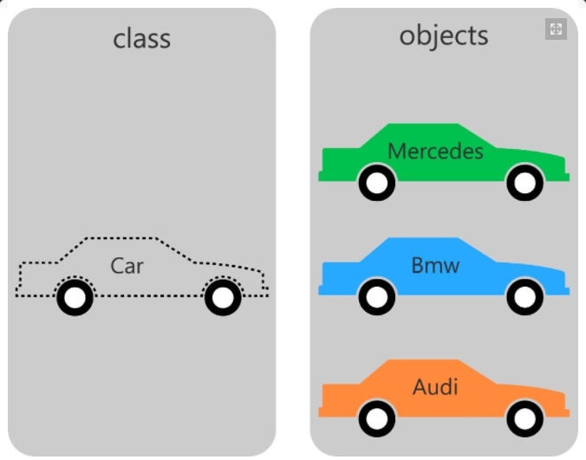

Slide 5
Example code:
class Cocacola
{
// variables
public string brand;
public string quantity;
public int price;
}
static void Main(string[] args)
{
// created one object
Cocacola item1 = new Cocacola() { brand = "Thumsup", quantity = "1 Litre", price = 50 };
//created another object
Cocacola item2 = new Cocacola() { brand = "Maaza", quantity = "1 Litre", price = 65 };
Console.WriteLine("Name: {0}, Quantity: {1}, Price: {2}",item1.brand,item1.quantity,item1.price);
Console.WriteLine("Name: {0}, Quantity: {1}, Price: {2}", item2.brand, item2.quantity, item2.price);
Console.ReadLine();
}

Slide 6
THANK YOU

